Slide 1
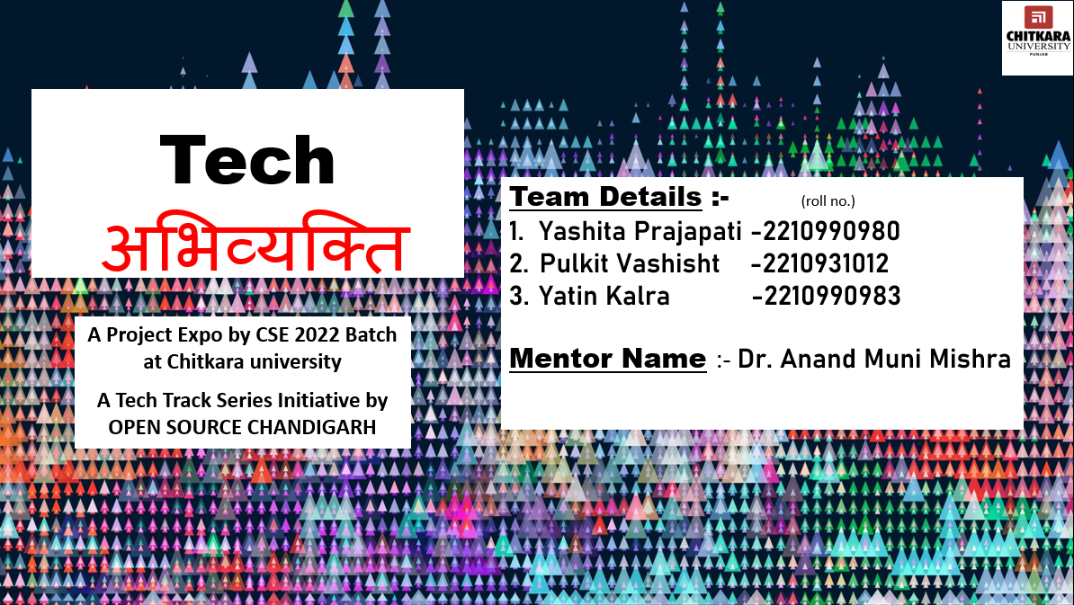
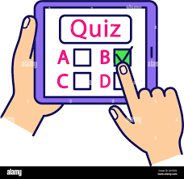
SUBMITTED BY:
SUBJECT:
INTERACTIVE QUIZ
Yashita Prajapati
Roll No. :- 2210990980
Yatin Kalra
Roll No. :- 2210990983
Pulkit Vashisht
Roll No. :- 2210931012
SUBMITTED TO:
Anand Muni Mishra
GROUP 30(AD)

Slide 2
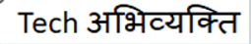


Interactive quiz
Mirjam Nilsson​

Slide 3
Points Undertaken In Presentation
Explaining the code
How does it works?
Clip of code
Clip of working of the quiz(code)
Future work/scope
Advantages/ Disadvantages
Conclusion
Bibliography
Acknowledgment
Introduction
Problem Statement
Modules used

Slide 4
Acknowledgment
We would like to thank Dr. Anand Muni Mishra, our mentor for his support and initial guidance in completing our project. It was a great learning experience.
This initiative would not have been a success without the contributions of each and every individual. We were always there to cheer each other on, and that is what kept us together until the end.
We guarantee that this project was created entirely by us. Finally, we’d like to express our gratitude to our parents and friends for their excellent comments and guidance during the completion of this project.

Slide 5
Introduction
A quiz is a form of game or mind sport in which players attempt to answer questions correctly about a certain or variety of subjects. Quizzes can be used as a brief assessment in education and similar fields to measure growth in knowledge, abilities, or skills.
They can also be televised for entertainment purposes, often in a game show format. In an educational context, a quiz is usually a form of a student assessment, but often has fewer questions of less difficulty and requires less time for completion than a test.
During this pandemic, giving online quizzes was one of ways teaching was done. As we know, young learners can easily get bored and lack focus when they study for long periods of time. In order to cope with this limitation, we have to design fun quizzes for students.
Unique features such as power-ups and live dashboard in Quizizz can boost their interest toward the quiz. Furthermore there are several benefits of giving online quizzes for students.
So we have tried to make a online quiz system.

Slide 6
Problem Statement
The first problem is lecturers need spend more time on grading. This is because lecturer need to check student paper one by one.
The second problem is difficult for students to answer quiz from any location. Quiz give an impact in coursework. Sometime some students have their own reason cannot take quiz on time.
In reality, lecturers and students were really important and they play a big role in setup the quiz. Besides, lecturers can test their students’ knowledge by grading. Here, the reasons to develop a web-based quiz system.

Slide 7
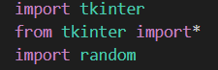
Modules Used
TKINTER :- Tkinter is the standard GUI (graphical user interface) library for Python. Python when combined with Tkinter provides a fast and easy way to create GUI applications. Tkinter provides a powerful object-oriented interface to the Tk GUI toolkit.
from tkinter import* :-
It is a method to import tkinter library to our code which comes with inbuilt methods or functions. We don’t have to explicitly override the method for the widgets.
import Random :-
Import random module is used to generate random float values. random() method helps to generate a random float value ranging from 0.0 to 1.0. There are no arguments required for the function.
It is used for shuffling the question each time when we run the program

Slide 8
Tkinter Widgets Used
frame :-The Frame widget was used as a container widget to organize other widgets.
text :-The Text widget was used to display text in multiple lines.
label :-The Label widget was used to provide a single-line caption for other widgets.
button :- The Button widget was used to display buttons for different questions in the quiz.
radiobutton :- It is used to implement one-of-many selection as it allows only one option to be selected.
Btnstart(buttonstart) :- it is used as a button which is used to start the quiz.

Slide 9
Indexes :- helps us to find the index position of an element or an item in a string of characters or a list of items. It spits out the lowest possible index of the specified element in the list. It is a global variable it is used for questions and answers.
main() :- Used to insert the main event loop to take action against each event triggered by the user.
Btnstart(buttonstart) :- It is used as a button which is used to start the quiz.
pack() :- It declares the position of widgets in relation to each other.
root :- It is used to define or locate a frame and is used for our interface.
Image_label.pack() :- It is used to define the location of picture and to apply background.
destroy :- This command destroys other option buttons once one option is selected.
pady :- puts some space between the button widgets and the borders of the frame and the borders of the root window.

Slide 10

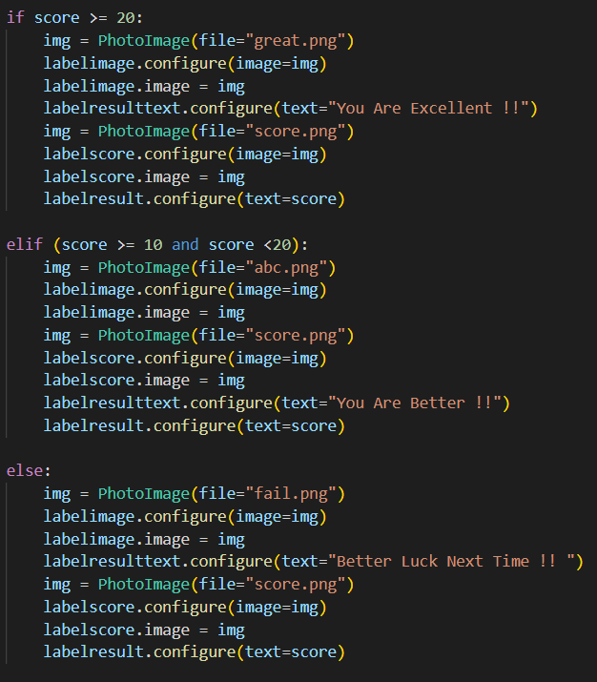
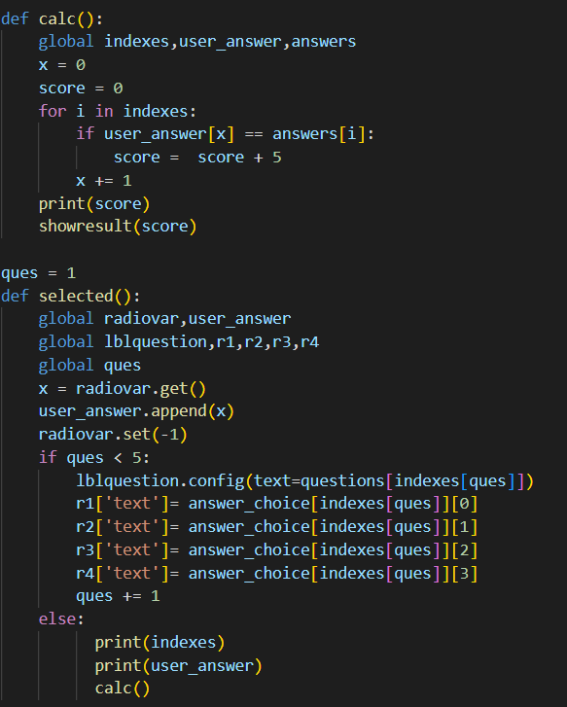
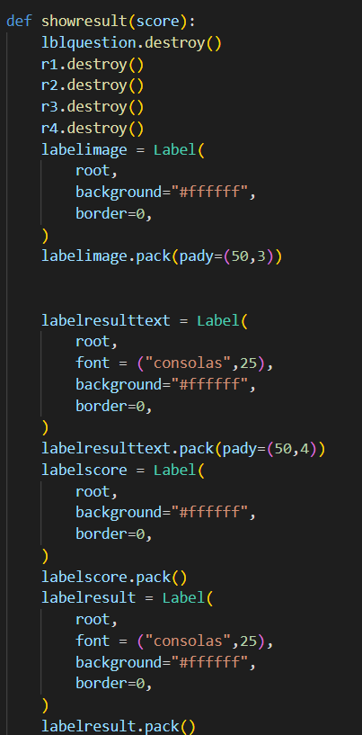
if statement will run when the score is between 20-25
Elif statement will run when the score is between 10-20
Else statement will run when both if and elif statements are wrong.
This part of code is for the last screen which displays the score card.
It is used for calculation of score(result).
Each question carries 5 marks so the
Marks obtained are out of 25.
This will destroy all options and will display the last result screen which contain the text, score and image simultaneously.

Slide 11
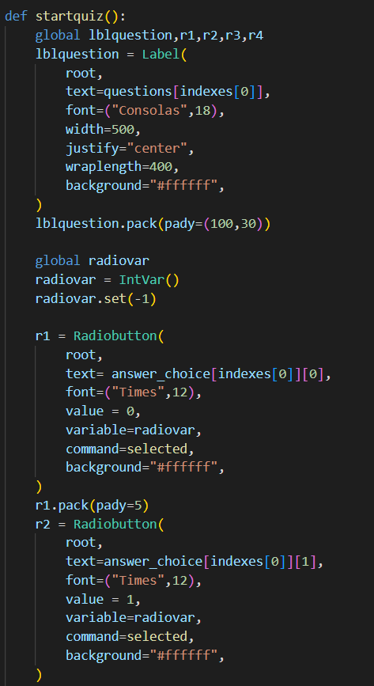
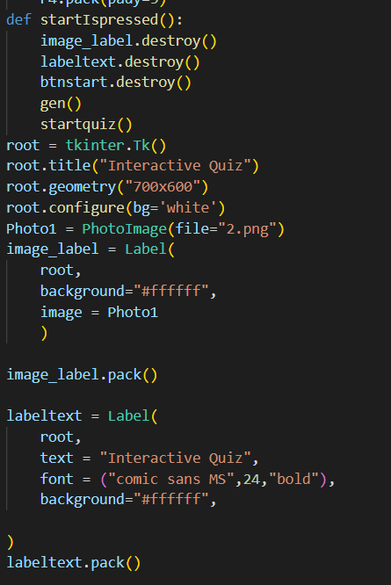
It is used for to decide what will be the font size or the structure of the statement
As soon as the start button is pressed it will trigger the startIspressed ,it is used to move to the next page and start the quiz
It is used to display the our question and answer of the quiz

Slide 12
→ Geometrical Management :
grid() :-
This geometry manager was used to organize widgets in a table-like structure in the parent or main widget.
pack( ) :-
This geometry manager was used to organize widgets in blocks before placing them in the parent or main widget.
Wrap length :-
It is used for setting alignment of the question.
Justify :-
It is used to centre align a question.

Slide 13
→ Standard Attributes :
Dimensions
Colors
Fonts
bg (background colour)
Images
Loops

Slide 14

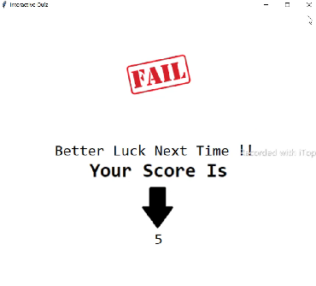
How does it works ??
Run the code. A pop up tk window will appear on the screen.
Start the test by pressing the start button that appears on the screen. After clicking on it the test will start.
Now attempt the question that appears on the screen.
After attempting one question; the next question appears automatically and then you cannot edit it, so on up to the no. of questions given.
After we attempt the last question, the result screen appears like

Slide 15
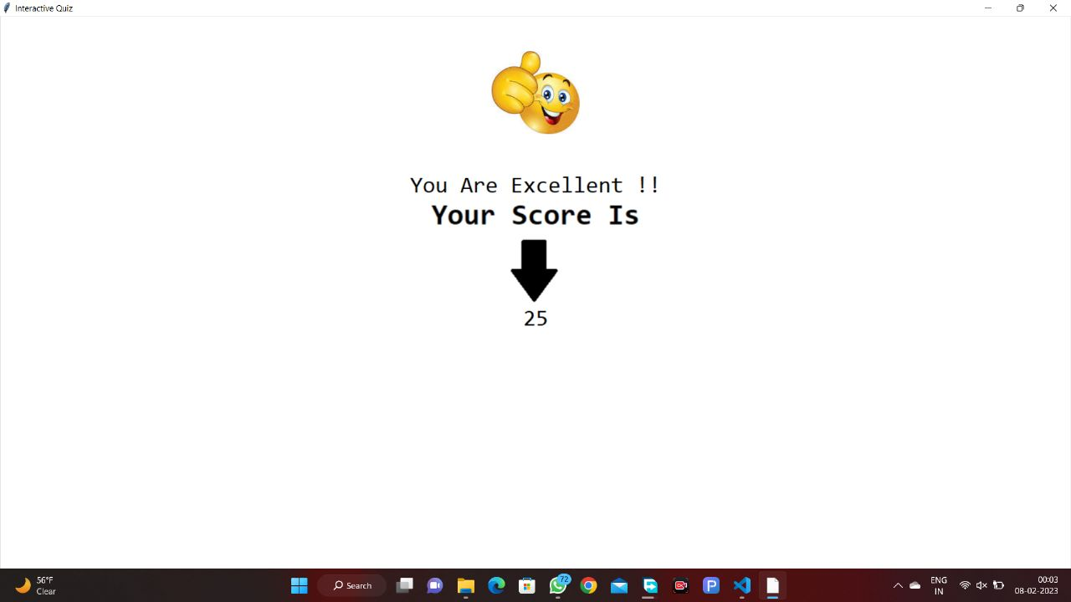
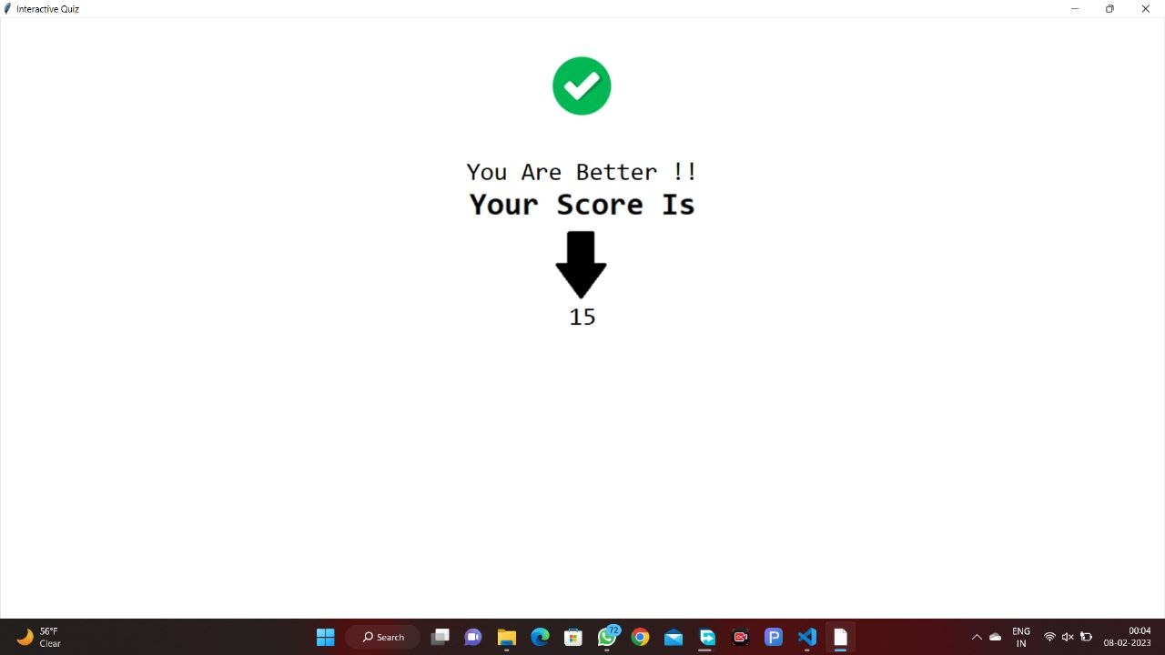
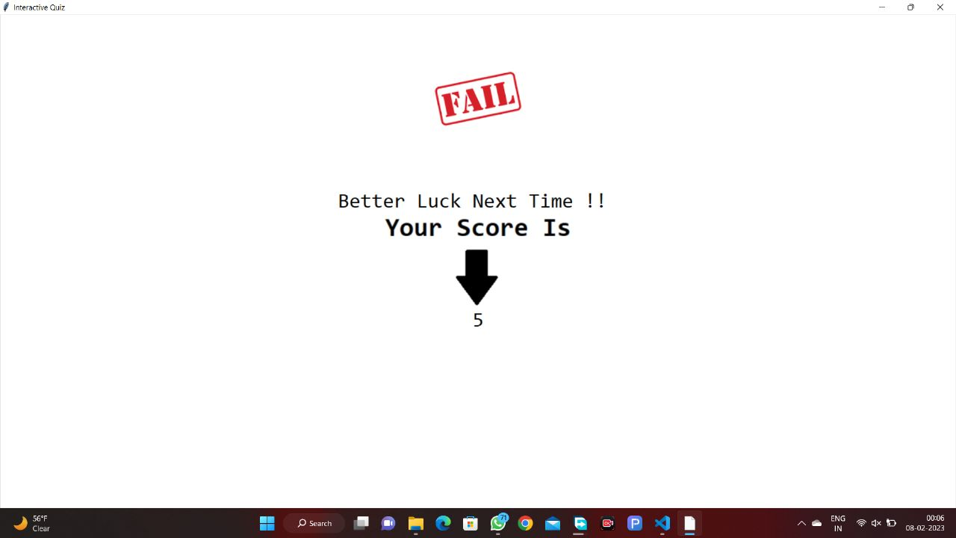
If the score is between 20-25 it will show -
If the score is between 10-20 it will show –
If the score is below 10 it will show -

Slide 16
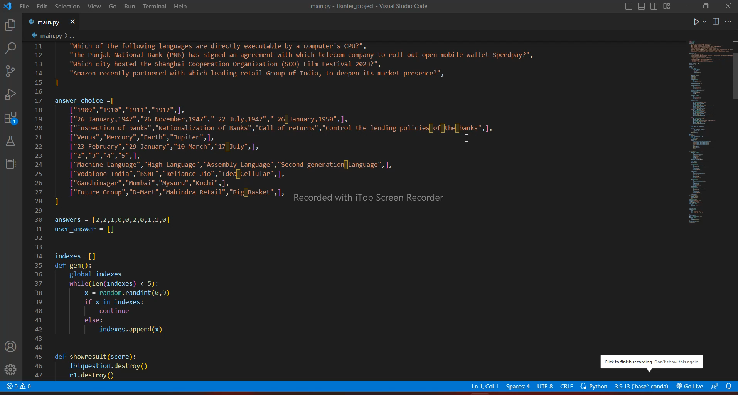
Clip of
code

Slide 17
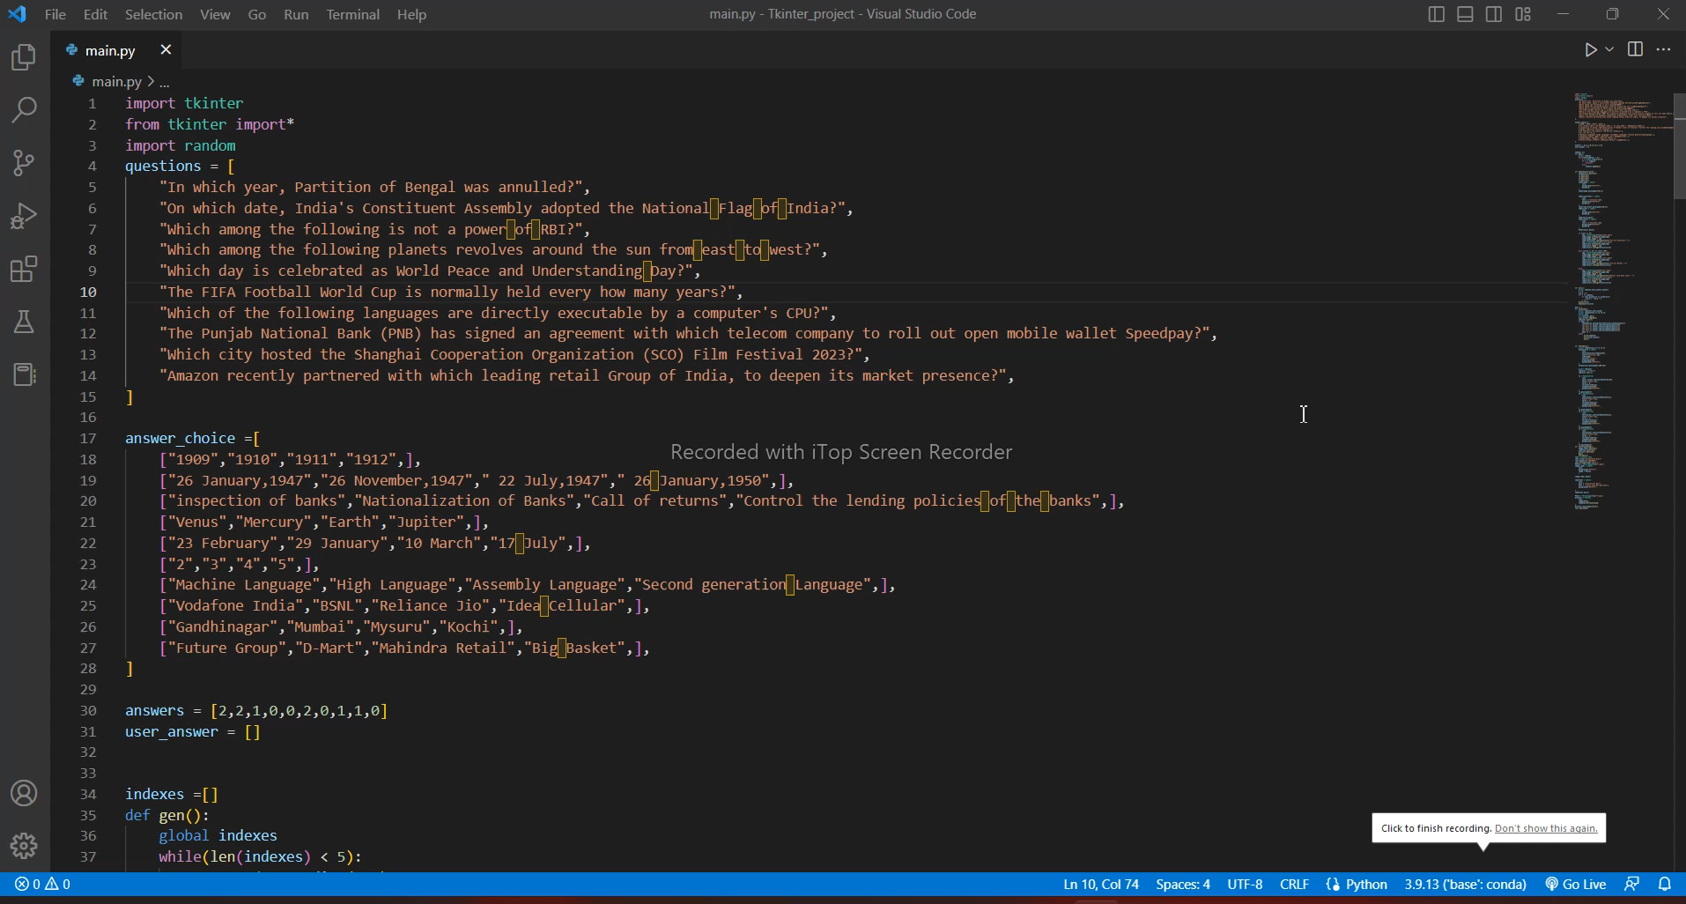
Clip of working of code
(Quiz)

Slide 18
Future Work / Scope / Objective
Today is the age of technology and innovation; you can find technology in every step you take. Whether you’re greeted in the morning by notifications on your phone or the school you go to. Technology is in every area of our lives, from the e-Books in the library to the online examination system used.
As time passes, new machines can continue to transition into different sectors and industries. Among these is the educational system that has begun to increase in popularity.
Online learning and testing may not be ideal and is the topic of many heated debates. However, one thing is for sure, the option is there, and it might be the only option available.
It evaluates the test takers freely and cost-effectively through computer-based tests.
It will be more effective system in future as the test can be conducted effortless , it reduces exam anxiety Amongst test takers, Promote social interaction between the test taker and experts, Prevents cheatings, Safe and secure data, Reduce administrative burden

Slide 19
→ Engage your audience. → A large number of participants. → Randomizing questions. → Quiz results/ gain insight in audience. → No instructor needed → Saves time and administration pressure
Advantages
Disadvantages
The quiz might be testing a user’s logical and interpretative skills rather than knowledge acquired.
Can restrict insights into how complete an understanding a learner has gained due to the element of chance involved.
Encourage guessing, and reward for correct guesses.

Slide 20
Conclusion
This project more focus on the problems who faced by the lecturers due to the manual system which are available now is not efficient. For instance, the losing of quiz paper, no pencil and no pen to do quiz on time. The lecturer cannot setup quiz for specific time and have to do quiz in class. Lecturer also need spend more time on grading. While, student also cannot take quiz from any location. This problems can be solved by Online Quiz System. In addition, this kind of system can be replaced the manual system in order to increase the efficiency of the quiz management.
While working on this project we came across a wide variety of modules which are used in Tkinter python. We learnt and experienced how working in group functions like. We are glad that we got the opportunity to work on this project as we discovered a lot of things.

Slide 21
Bibliography
https://www.google.com/search?q=chitkara+university&rlz=1C1ONGR_en&oq=chitkara+university&aqs=chrome..69i57j69i61.6214j0j7&sourceid=chrome&ie=UTF-8#imgrc=TDc02ozqZCKRJM%253A
https://en.wikipedia.org/wiki/Quiz
https://en.wikipedia.org/wiki/Quiz
https://pngtree.com/free-png
https://www.geeksforgeeks.org/what-are-widgets-in-tkinter/
https://www.tutorialspoint.com/python/python_gui_programming.htm#:~:text=Tkinter%20is%20the%20standard%20GUI,to%20the%20Tk%20GUI%20toolkit.&text=Import%20the%20Tkinter%20module.

Slide 22
Thank you
Efforts by:
Yashita Prajapati(2210990980)
Yatin Kalra(2210990983)
Pulkit Vashisht(2210931012)

